Slide 1

Biochemical Food Tests
An Interactive 5-Part Science Activity
Testing for Reducing Sugars • Starch • Fats • Proteins

Slide 2
Why Do We Need Food Tests?

Slide 3
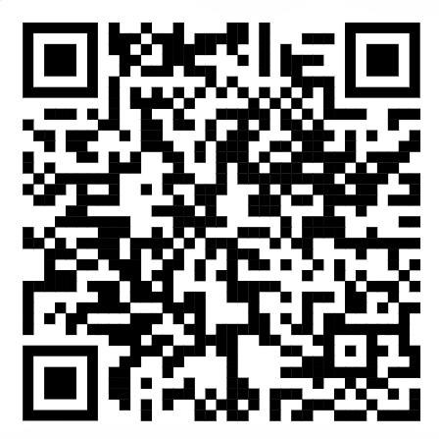




What’s Inside This Activity
Five hands-on activities take you from learning the tests to applying them like a forensic scientist.
Activity 1: Learn the Tests
Run Benedict’s, Iodine, Ethanol Emulsion, and Biuret tests on known food samples.
Activity 2: Mystery Samples
Test unknown samples and work out which nutrients they contain.
Activity 3: Procedures
Put each test’s scrambled steps back into the correct order.
Activity 4: Vomit Lab
Analyze forensic samples to crack three real-world case files.
Activity 5: Check Your Understanding
Five questions to test what you’ve learned across all four tests.
Overview
Biochemical Food Tests

Slide 4
Activity 1: Learn the Tests
Four biochemical tests, four macromolecules, four colour changes to remember.
Benedict’s Test
Iodine Test
Tests for: Reducing Sugars
Tests for: Starch
Sample: Apple juice
Sample: Potato extract
Positive result: Blue → Brick-red
Positive result: Orange-brown → Blue-black
Ethanol Emulsion Test
Biuret Test
Tests for: Fats
Tests for: Proteins
Sample: Olive oil
Sample: Egg white solution
Positive result: Clear → Cloudy white
Positive result: Blue → Violet
Activity 1
Biochemical Food Tests

Slide 5

Activity 2: Mystery Samples
Test three unknown foods with all four reagents, then decide what nutrients are hiding inside.
How it works
Run Benedict’s, Iodine, Ethanol, and Biuret on the sample → read the colour results → pick the matching nutrient combination.
Sample A
Sample B
Sample C
Honey solution
Bread extract
Milk
Reducing Sugars
Starch & Proteins
Sugars, Fats & Proteins
Activity 2
Biochemical Food Tests

Slide 6
Activity 3: Procedures
Steps get scrambled — drag them back into the correct order. Here’s Benedict’s Test, worked example:
1
2
3
4
5
Add Benedict’s reagent to the sample
→
Shake the mixture thoroughly
→
Heat the water bath until it boils
→
Leave test tube in boiling water for 2 min
→
Observe the colour change
Also covers: Biuret Test for Proteins • Ethanol Emulsion Test for Fats
Activity 3
Biochemical Food Tests

Slide 7

Activity 4: Vomit Lab
Crack three forensic case files by testing a sample and matching it to the culprit meal.
Case File #1
Case File #2
Case File #3
Case 1: The Salad Lie
Case 2: The Cafeteria Mystery
Case 3: Late-Night Snack Confession
Jordan says it was just a salad. The tests say otherwise.
Three sick students, one common food. Find it.
No one touched the snack table… or did they?
Activity 4
Biochemical Food Tests

Slide 8
Activity 5: Check Your Understanding
Wrap up with five multiple-choice questions covering everything from Activities 1–4.
5
4
1
Questions
Options Each
Attempt to Reflect
Sample Question
What colour change indicates a large amount of reducing sugars in Benedict’s Test?
A. Blue to brick-red ✓
B. Blue to blue-black
C. Clear to cloudy white
D. Blue to violet
Activity 5
Biochemical Food Tests

Slide 9

Key Concepts to Remember
One test, one reagent, one colour change — four times over.
Reducing Sugars
Starch
Fats
Proteins
Benedict’s solution + heat → brick-red precipitate
Iodine solution → blue-black
Ethanol + water → cloudy white emulsion
NaOH + CuSO₄ drop by drop → violet
Recap
Biochemical Food Tests

Slide 10

Ready to Get Started?
Work through all five activities, then use the worksheet to record your results.

